Slide 1
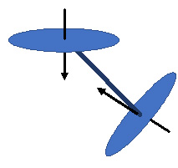
Thermal radiation
The contributors, timeline, and impact of the giants in the history of the discipline
Jack Howell
The University of Texas at Austin

Slide 2

WhY should we care about radiation??
Radiation can pass through a vacuum. A good thing, because otherwise we couldn’t get energy from the Sun.
Modern technology is finding more and more applications…… lasers; solar power; astrophysics (radiation is the only way to observe the behavior of objects in space); remote sensing; global warming; nano surfaces for improved energy harvesting, etc. etc.

Slide 3
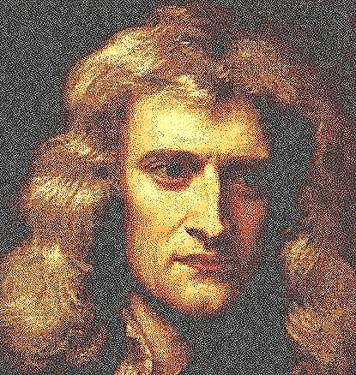
At the start: Sir Isaac newton (1634-1727) looks at light
Sir Isaac postulated in 1672 that light is made up of individual “corpuscles” that each carry attributes of color. Refraction was caused when a material like glass attracted the corpuscles and caused them to speed up and change path. When asked why some light was reflected, he proposed that matter had “fits of attraction and fits of repulsion.”

Slide 4
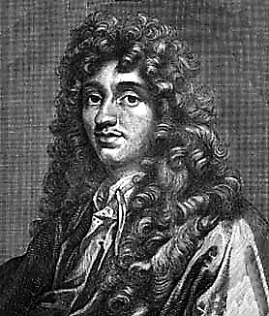

Huygens says “baloney”
Christiaan Huygens (1629-1695) visited Newton in 1689.
On his return to Holland in 1690 he published his own treatise in which he proposed light was not corpuscular, but rather made up of longitudinal (ocean-like) waves. The immense reputation of Newton led to rejection of any theory which he rejected, and to the early adoption of the corpuscular theory over wave ideas.

Slide 5
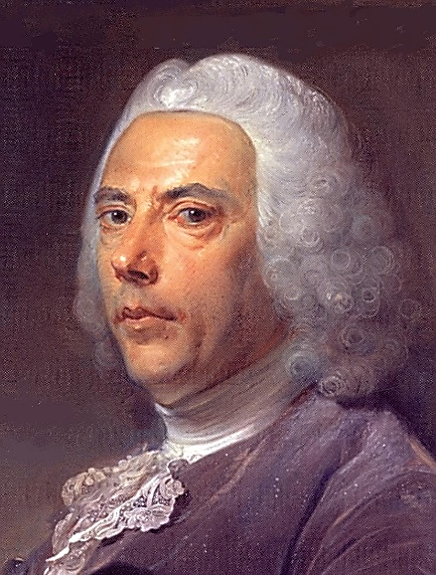
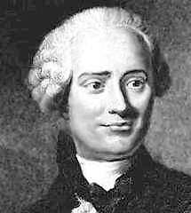
LIGHT FADES WHEN PASSING THROUGH MATTER
Pierre Bouguer (1698-1758) in 1729 first discovered the law of exponential decay of light intensity through an absorbing medium (in his case, the atmosphere).
Johann Heinrich Lambert (1728-1777) in 1758 also described the exponential decay of light, and in 1760 his book Photometrie described the exponential decay as well as the cosine dependence of the emission from a diffuse surface. (He was the first to prove that π was an irrational number.)

Slide 6
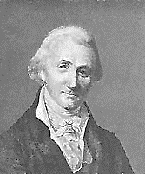
Prevost proves WE are ALL radiating right now!
Pierre Prevost (1759-1839) proposed in 1791 that all bodies emit radiation all the time, regardless of their surroundings (Prevost’s Law)

Slide 7
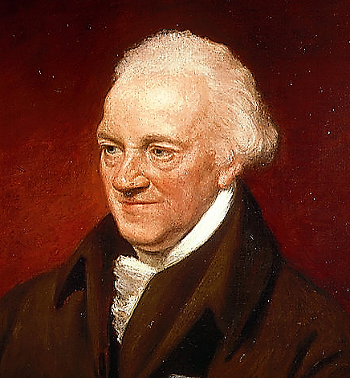
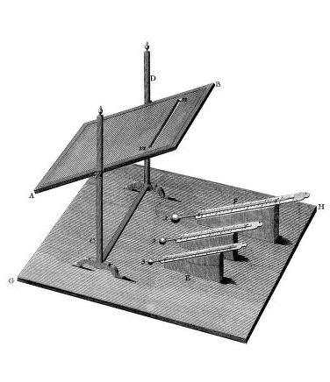
There’s more to the spectrum than we can see!
In 1800, Sir William Herschel (1738-1822) discovered the presence of infrared energy in
sunlight by passing it through a prism and holding a thermometer just beyond the red end of the visible spectrum. It showed a higher temperature than the visible spectrum, implying energy in the then unknown infrared portion of the spectrum.

Slide 8
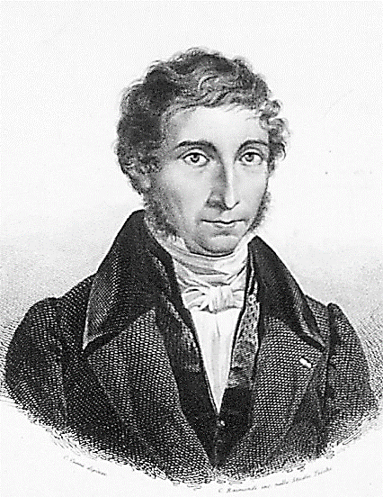
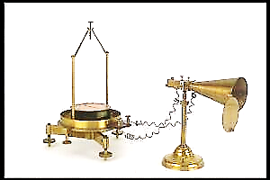
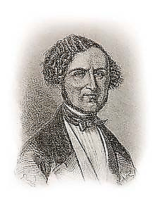
NOBILI AND MELLONI SHOW THAT LIGHT AND RADIANT ENERGY ACT THE SAME
Leopoldo Nobili (1784-1835) and Macedonio Melloni (1798-1854) developed a thermopile-based radiometer and measured radiation from various sources. They showed (1831) that different surfaces emitted differing amounts of radiation at the same temperature, and that the radiometer reacted similarly to light sources and heated surfaces.

Slide 9
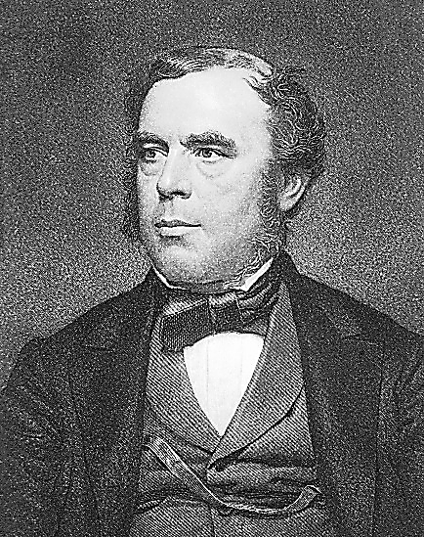
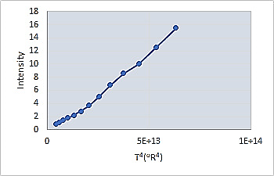
Draper just misses fame
John William Draper (1811-1882) in 1847 observed the Draper point of 798K (977ºF) at which emission from a hot object becomes visible to the eye. He also presented data on the radiation emission vs. temperature from a heated object (replotted here on an absolute T⁴ scale) but failed to recognize the fourth-power dependence, (because an absolute temperature scale was not yet in use.)

Slide 10
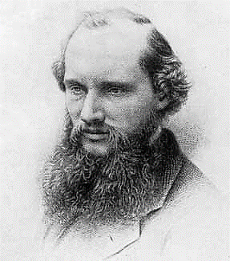
Now an absolute tEMPERATURE scale…..
William Thomson, Lord Kelvin (1824-1907): “I often say that when you can measure what you are speaking about, and express it in numbers, you know something about it; but when you cannot measure it, when you cannot express it in numbers, your knowledge is of a meagre and unsatisfactory kind.” He proposed his absolute temperature scale in 1848 based on Sadi Carnot’s work on ideal thermodynamic cycles.

Slide 11
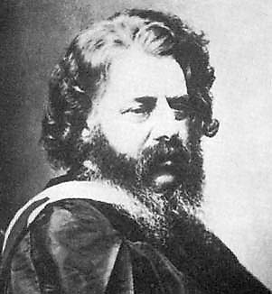
Another absolute temperature scale…
.
William John Macquorn Rankine (1820-1872) was a Scottish engineer who proposed the Rankine absolute temperature scale in 1859. He was also a poet, writing:
The Mathematician in Love,
and a composer:
They Never Shall Have Gibraltar.

Slide 12
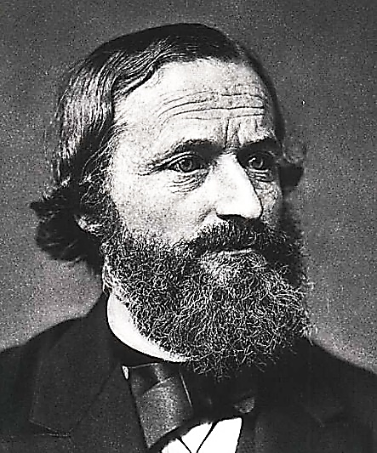
Absorptivity = emissivity:
Kirchhoff’s law
Gustav Robert Kirchhoff (1824 -1887) proposed in 1859 and proved in 1861 that “For an arbitrary body emitting and absorbing thermal radiation in thermodynamic equilibrium, the emissivity is equal to the absorptivity.” He described the ideal radiation emitter in 1862 and called it the schwarzer körper (blackbody) because the perfect emitter must also be the perfect absorber and therefore a zero reflector that would appear black to the eye.

Slide 13
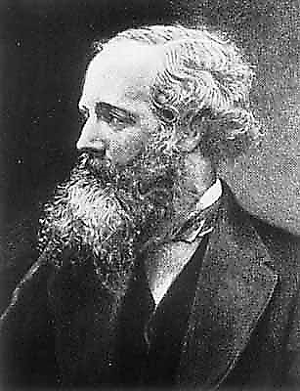

Huygens was right, but the WAVES are transverse (LIKE waving a clothEsline), not longitudinal like SOUND OR OCEAN waves
James Clerk Maxwell (1831-1879), is often considered the most influential physicist after Einstein and Newton. In 1865, he described the propagation of an electromagnetic wave using a system of 20 equations and showed that electromagnetic wave speed was equal to the speed of light, implying that light was itself an electromagnetic wave.

Slide 14
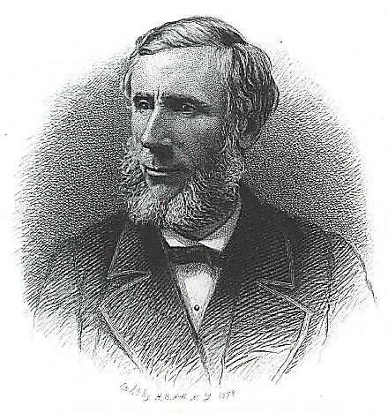
MOLECULAR GASES CAN AFFECT METEOROLOGY--- 1872
John Tyndall (1820-1893) found that differing types of molecules have differing absorption of infrared radiation and that the absorption behavior of molecules is quite different from that of the atoms. In 1872 he demonstrated a kinship between the molecular mechanisms of absorption and emission in gases. He saw that moist air was a much better radiation absorber than dry air and speculated on what this meant in terms of meteorology and climate.

Slide 15
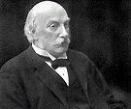
Rayleigh explains why the sky is blue and sunsets are red
In 1859, Tyndall had discovered that bright light scattering off particles was faintly blue-tinted. He conjectured that a similar scattering of sunlight gave the sky its blue hue but couldn’t explain why.
In 1871, John William Strutt, Lord Rayleigh (1842-1919) published on the color and polarization of skylight to quantify Tyndall's effect. In 1881 with the benefit of Maxwell's 1865 proof of the electromagnetic nature of light, he showed that his equations followed from electromagnetic theory.

Slide 16
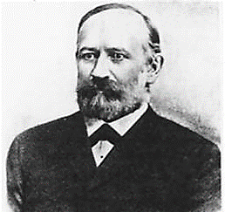
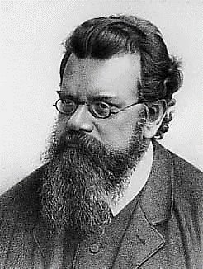
STEFAN AND BOLTZMANN SHOW RADIATION IS PROPORTIONAL TO T⁴……. POOR DRAPER!
Josef Stefan (1835-1893) proposed Stefan's law in 1879: The total (all wavelengths) radiation from a blackbody is proportional to the fourth power of its absolute temperature. In 1884, the law was derived from thermodynamic analysis by Stefan's student Ludwig Edward Boltzmann (1844-1906) and is now known as the Stefan–Boltzmann law.
[Using his law, Stefan determined the temperature of the Sun's surface to be 5,430 °C (5700 K), comparable to the accepted value of 5780 K.]

Slide 17
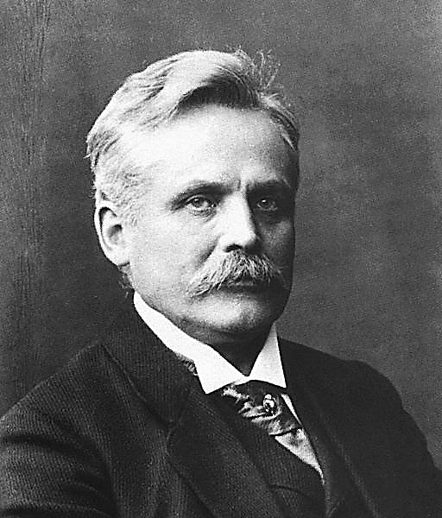
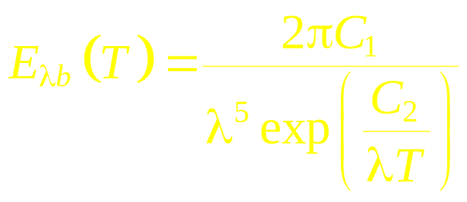
HOW IS ENERGY DISTRIBUTED WITH WAVELENGTH FOR A BLACKBODY??
Wilhelm Carl Werner Otto Fritz Franz (Willy) Wien (1864-1928) proved in 1893 that the product of peak emission wavelength and absolute temperature for a blackbody is a constant (Wien’s Law). In 1896, he presented a spectral distribution of radiation from a black- body based on energy distributions proposed by Maxwell and Boltzmann. (Max Planck said it looked good to him!) This earned Wien the 1911 Nobel Prize in physics.

Slide 18
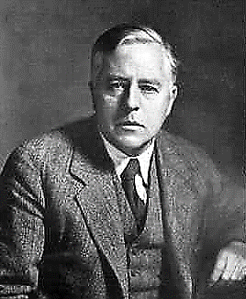
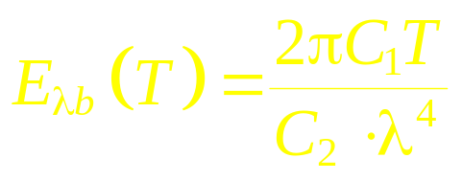
RAYLEIGH AND JAMES HOPWOOD JEANS (1877-1946) TRY ANOTHER APPROACH…
Rayleigh and Jeans applied the classical idea of equipartition of energy (1900, 1905) to vibrating energy states in a solid to predict the spectral distribution of blackbody radiation. It worked at long wavelengths but went quite wrong at short wavelengths (the ultraviolet catastrophe.)

Slide 19
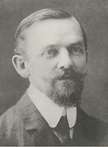
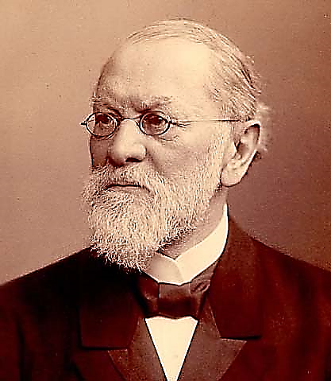
WIEN’S DISTRIBUTION IS OUTSIDE THE EXPERIMENTAL ERROR!
Otto Richard Lummer (1860-1925) and Ernst Pringsheim (1859-1917) developed the radiometer for accurately measuring infrared radiation. In 1896, they measured the spectral distribution of radiation energy from a blackbody.
In September 1900 they published results showing the “invalidity of the Wien-Planck spectral equation.” This stimulated Max Planck to seek a new radiation expression.

Slide 20
SO… HAVE MADE IT TO 1900……..
What did we know at that time?
Radiation is well described as an electromagnetic wave.
The ideal blackbody radiates in proportion to its absolute temperature to the fourth power, and λ_{max}T = constant.
We have some information on atmospheric scattering and absorption of radiation, leading to understanding of why the sky is blue, sunsets are red, and speculation on why and how polyatomic gases (H₂O, CO_{2,} CH₄) may affect the weather.
What we didn’t know: Exactly how is emitted radiation from a blackbody distributed across the spectrum? But we’re close.

Slide 21
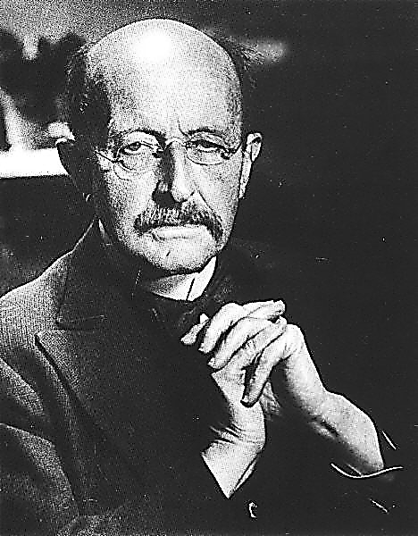
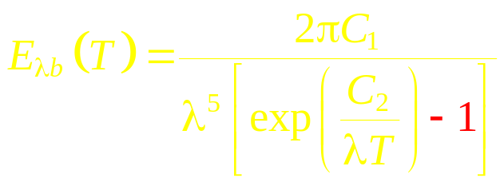
NOW FOR THE BIGGIE………
Max Planck (1858-1947) developed his blackbody spectral distribution in 1900-1901. He observed that the denominator in Wien’s equation needed to be slightly smaller to fit the data of Lummer and Pringsheim. He stuck in a (-1), and it now matched the experiment!
Wien
Planck

Slide 22
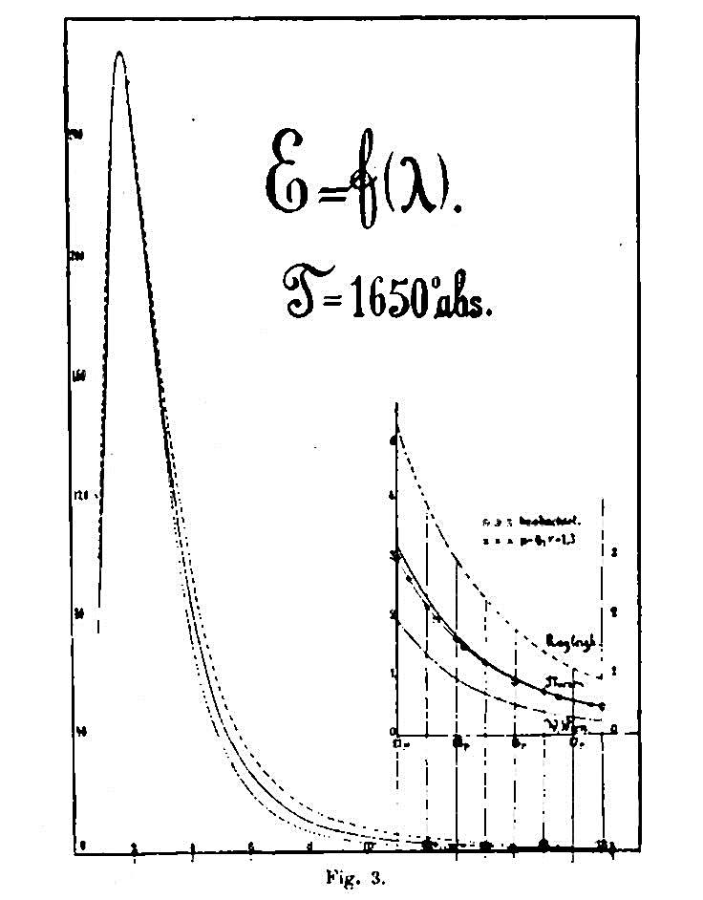
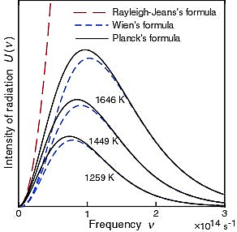
PLANCK’S CURVE SHOWS AGREEMENT WITH THE DATA.
Original Lummer
And Pringsheim data
Both the Wein and Rayleigh-Jeans distributions can be derived as limiting cases of Planck’s distribution. The Wien Law, λ_{max}T = constant and the fourth power Stefan-Boltzmann Law also result.

Slide 23
OK MAX, SO THE -1 WORKS. NOW TELL US WHY!
Explaining the theoretical basis for the -1 forced Planck to propose quantized energy levels…..at odds with classical physics. A very controversial step, rejected by most physicists at the time.
This laid the basis for modern quantum physics. Remember, Wien got the Nobel Prize in 1911. Planck finally got it in 1918.

Slide 24
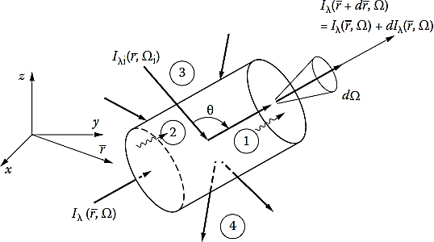
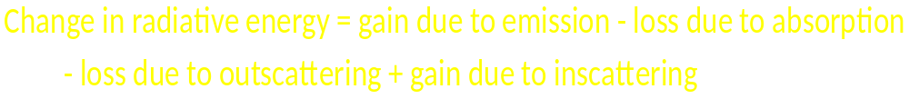
The basics are in… Now use them to solve real RADIATION problems
This generally means solving the Radiative Transfer Equation (RTE)……. Describes radiation traveling through an absorbing-emitting-scattering medium:
In mathematical form, this is an integral-differential equation, with no simple solutions unless make a lot of simplifying (and thus error-inducing) assumptions.

Slide 25
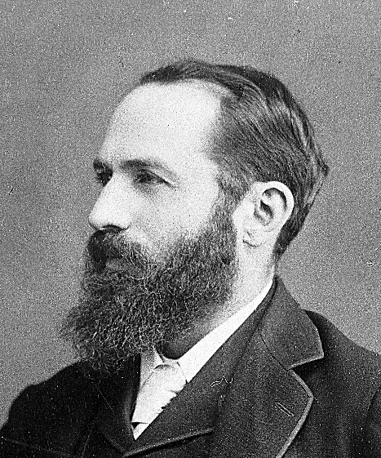

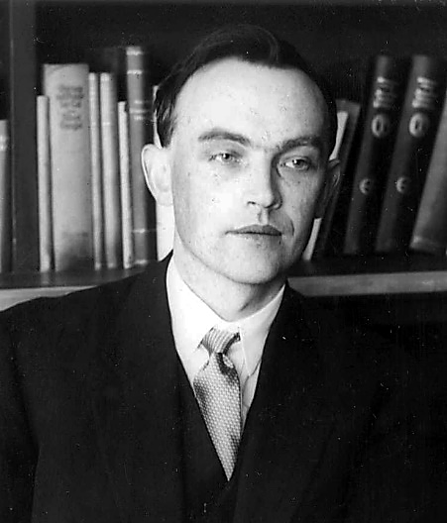
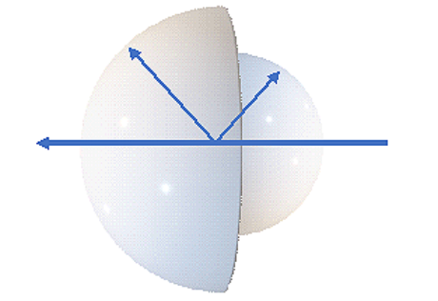
Astrophysicists Try to Understand Solar Radiation
Franz Arthur Friedrich Shuster (1851-1934) and Karl Schwarzschild (1873-1916) in 1905-6 developed a two-stream solution to the 1-D RTE by assuming a different uniform intensity in the forward and backward hemisphere of directions.
Svein Rosseland (1894-1985) provided a solution to the RTE in 1924 by assuming that the medium was nearly opaque.

Slide 26
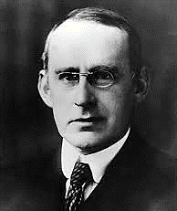
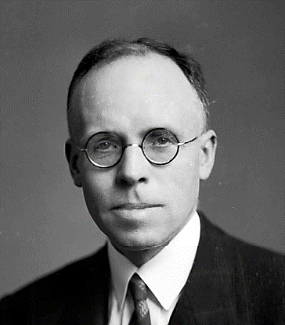
ANOTHER TRY AT A SOLUTION
Edward Arthur Milne (1896-1950) and Arthur Stanley Eddington (1882-1944), in 1926-30 provided a second solution to the 1-D radiative transfer equation (after Schuster-Schwarzschild) based on a two-flux (rather than two intensity) model.
Will stop discussing RTE solutions now……… because in about 1950, the computer makes its appearance, making numerical, rather than analytical, solution of the RTE possible. Can get rid of the assumptions!

Slide 27
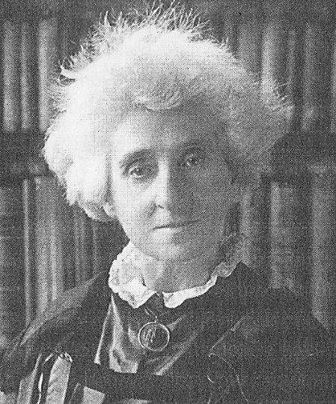
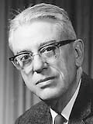
HAVE LEFT OUT MANY IMPORTANT FOLKS, e. g.:
Margaret Lindsay Huggins (1848-1915) and her husband first showed that the stars were suns by the similarity of their spectra with that of our Sun. The spectrum of the star Sirius showed a slight Doppler shift, indicating that it was moving away from the Earth. This led to the discovery of the expanding universe.
Hoyt Clarke Hottel (1903-1998) developed gas emissivity charts for the important combustion gases, the crossed-string method for determining configuration factors in 2D geometries, and established the basis for treating radiation in furnaces, including the zone method. A true engineer!

Slide 28
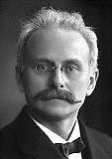
WERE THEY ALL STABLE GENIUSES?
Boltzmann committed suicide in 1906 because of criticism of his work.
Johannes Stark (1874-1957) won the Nobel Prize in 1919 for EM effects on spectral lines, became a Nazi sympathizer and was convicted of war crimes after WWII.
Kelvin said: “Radio has no future," "X-rays are clearly a hoax," and "The aeroplane is scientifically impossible.”

Slide 29
A LAST OBSERVATION….
The joy of creativity is often thought of as being an integral part of the arts, and it certainly is.
But joy in discovery is also a reward that I’m sure was felt by all of those pictured here, and indeed any scientist or engineer who experiences that “aha” moment when he/she experiences the beauty of discovery… whether of a new phenomena or a new understanding.
Is this a great profession or what??

Slide 30

HOPE THAT WAS A FUN TOUR.

